Slide 1
Digital Portfolio
STUDENT NAME:NAME: SUMITHRA REGISTER No AND NMID: 247247u18038 & 9DB2745AF31EAAB93D74020E00EEDD57 DEPARTMENT: COMPUTER SCIENCE COLLEGE: CHEZHIAN ARTS & SCIENCE COLLEGE FOR WOMEN / THIRUVALLUR UNIVERSITY

Slide 2
PROJECT TITLE web developer
Notes:
Web developer

Slide 3


AGENDA
Problem Statement
Project Overview
End Users
Tools and Technologies
Portfolio design and Layout
Features and Functionality
Results and Screenshots
Conclusion
Github Link
3/21/2024 Annual Review

Slide 4

PROBLEM STATEMENT
Lack of a professional online presence for showcasing skills and projects.
Difficulty in presenting technical expertise to recruiters or clients.
Traditional resumes fail to highlight creativity and interactive abilities.
Limited accessibility to achievements, certificates, and project details.
Need for a portfolio with minimal contact details to ensure privacy and professionalism.

Slide 5

PROJECT OVERVIEW
A personal digital portfolio designed to showcase web development skills, projects, and achievements.
Responsive, modern, and user-friendly layout with essential sections like About Me, Skills, and Projects.
Acts as a professional platform to connect with recruiters and clients while maintaining minimal contact details.

Slide 6

WHO ARE THE END USERS?
Recruiters and hiring managers – to evaluate technical skills and projects.
Clients and businesses – to explore web development services.
Peers and collaborators – to connect for teamwork or knowledge sharing.
Students and learners – to get inspiration from the portfolio design and content.

Slide 7

TOOLS AND TECHNIQUES
HTML5 & CSS3 – for building the structure and styling of web pages.
JavaScript – to add interactivity and dynamic behavior.
Bootstrap / Tailwind CSS – for responsive and modern design layouts.
Git & GitHub – for version control, collaboration, and hosting projects.
VS Code – as the main development environment.

Slide 8
POTFOLIO DESIGN AND LAYOUT
Clean and modern interface with dark/light theme options.
Responsive design for mobile, tablet, and desktop devices.
Well-structured sections: About Me, Skills, Projects, Achievements, Contact.
Minimal contact details for privacy while maintaining professionalism.
8

Slide 9
FEATURES AND FUNCTIONALITY
Interactive header and navigation for smooth user experience.
Dynamic project showcase with descriptions and links.
Achievements and certifications displayed in a professional format.
Minimal contact section with email, GitHub, and LinkedIn links.
Responsive layout ensuring accessibility across all devices.

Slide 10
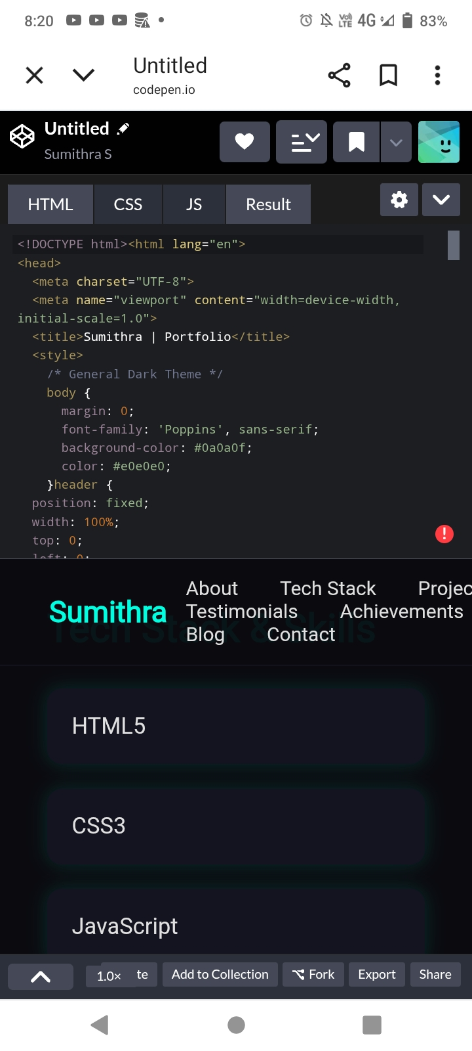
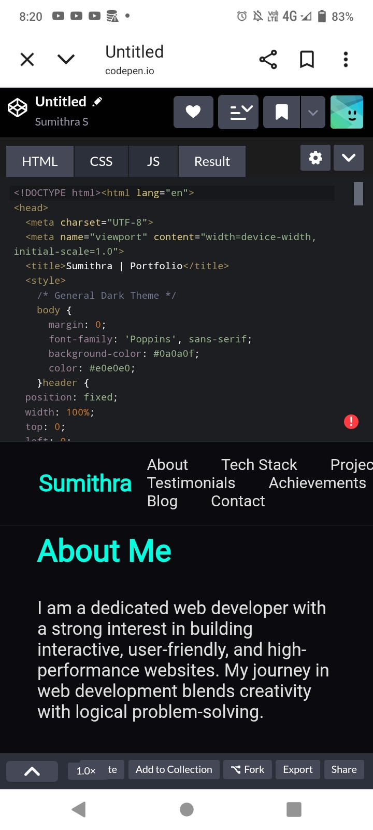

RESULTS AND SCREENSHOTS
3/21/2024 Annual Review
10

Slide 11

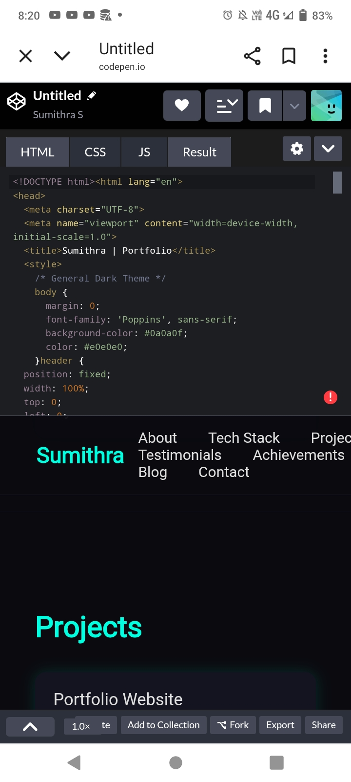
SCREENSHOT

Slide 12
GITHUB LINK
https://github.com/sumithrasasi128-ship-it/Web-developer-.git

Slide 13
CONCLUSION
The portfolio website effectively highlights web development skills and achievements.
Provides recruiters and clients with a professional platform to evaluate work.
Ensures privacy by sharing only minimal contact details.
Demonstrates the ability to design, develop, and deploy responsive websites.
13

